Slide 1

JİRA İNTERVİEW

Slide 2

What is Jira?
Jira is a tool developed to help teams for project management, bug tracking, and issue tracking. In simple terms, it is an issue tracker. Jira is widely used by big companies in software development and software testing.
NOT: https://www.atlassian.com/

Slide 3
List the Atlassian products that are members of Jira family.
Jira is divided into four different products and the term Jira is referred to as a common platform in which all these products are created. The four products of the Jira family are: Jira Software, Jira Align, Jira Core, and Jira Service Desk.

Slide 4
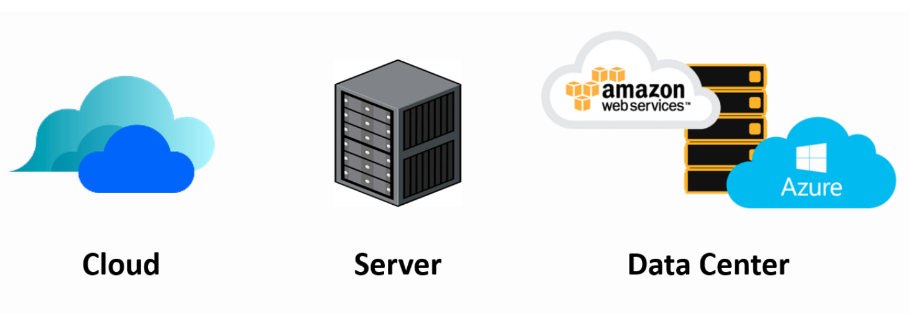
Which hosting options are available for Jira Software?
There are three hosting options available: Atlassian Cloud, Server, and Data Center (Amazon Web Services (AWS) and Microsoft Azure).

Slide 5

Is it possible to access JIRA cloud site via a mobile device?
You can access your Jira Software site from mobile devices by typing the address of your site into web browsers.

Slide 6

What is project key in Jira Software?
A project key is a unique code for your project. Jira Software will automatically generate a short project key in accordance with your project name. However, if you want to specify this auto-generated key yourself, you can change it.

Slide 7
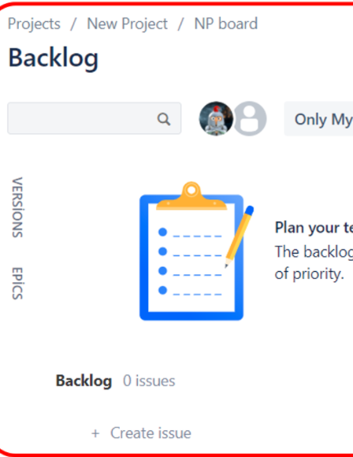
Explain briefly what is backlog.
A backlog is a list of issues that can be created for your project. You can create issues and sprints in the backlog. Then, you can add issues to a sprint so that your team can work on it.

Slide 8

Explain briefly what is version.
The versions represent the points of a project over time. With versioning, you can plan the order in which new features and fixes for the product will be released to your customers.

Slide 9

List and briefly describe the issues types in Jira Software.
Epic : An epic is a set of jobs that can be divided into manageable user stories.
Story : A story is a short requirement written from an end-user perspective.
Task : A task represents the job that needs to be done.

Slide 10
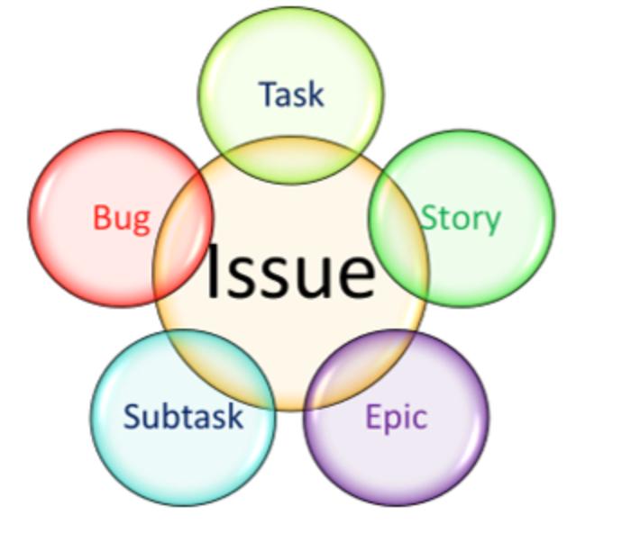
List and briefly describe the issues types in Jira Software.
Subtask : A subtask can be considered as a smaller piece of a story.
Bug : A bug impairs expected functionality of the product.

Slide 11
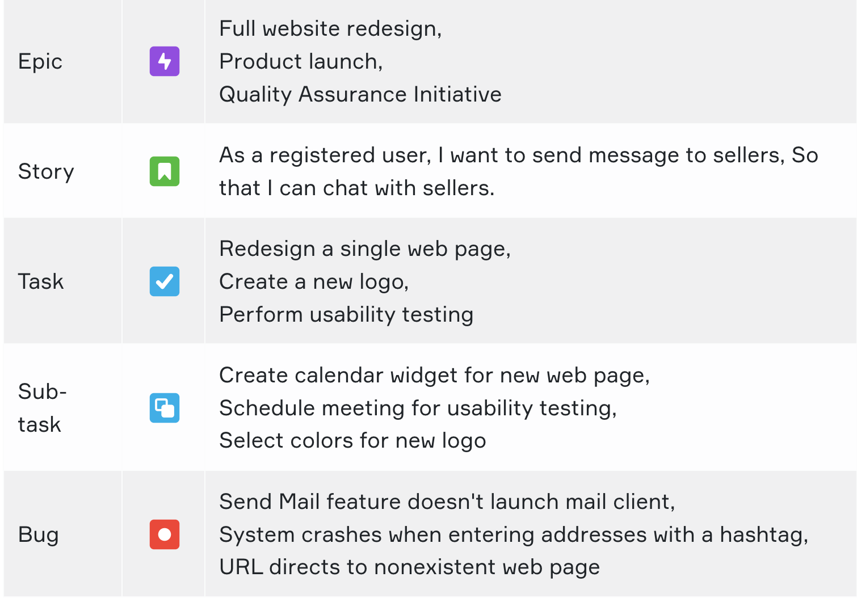
Issue Types

Slide 12
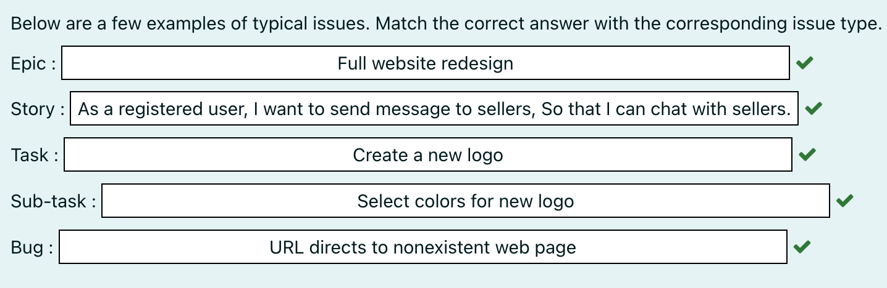

Slide 13
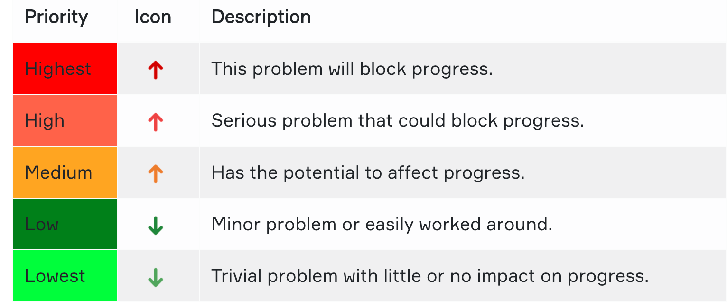
Issue Priorities

Slide 14
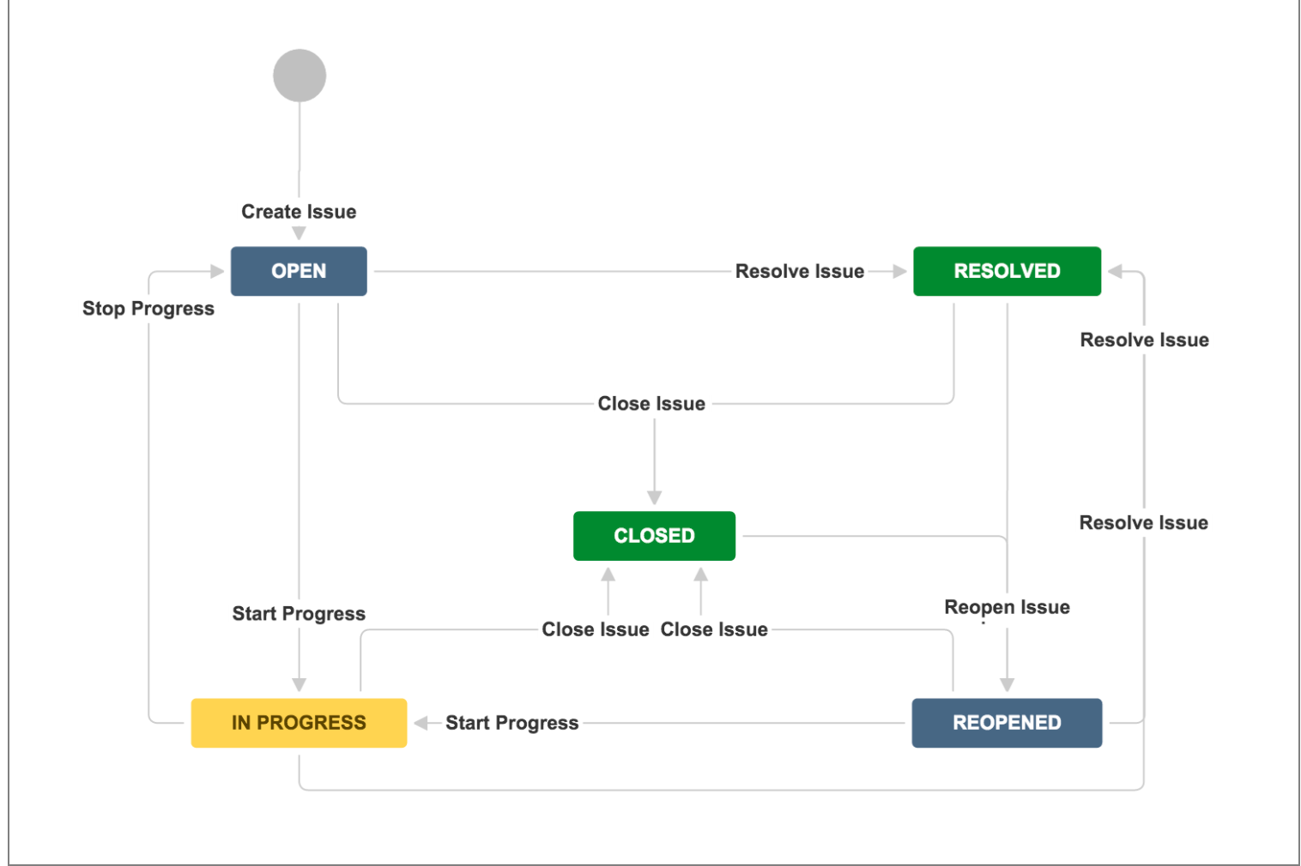
What is Jira Workflow?
A Jira workflow is a set of statuses and transitions that an issue moves through during its lifecycle, and typically represents a process within your organization. Workflows can be associated with particular projects and, optionally, specific issue types by using a workflow scheme.

Slide 15

What is an epic in Jira Software?
An epic is a set of jobs that can be divided into manageable and shippable user stories based on the needs of customers. Epic is the best way to group similar user stories. It may take several sprints to complete an epic.

Slide 16

Explain how a subtask is created in Jira Software.
Follow these steps to create a subtask. Click on an issue where you want subtasks to be created. From the dialog box, click on the "Create subtask" button. Add a summary to your subtask and click on "Create" button. Click on a subtask that you have created and you can do the followings: Attach file, Link issue, Link page, Change status, Assign an assignee, Assign an reporter, Edit labels, Determine priority.

Slide 17

Which hosting options are available for Jira Software?
Teams can use Jira Software with two hosting options: cloud and self-managed. Customers using the self-managing option can choose between server and data center.
Cloud: With Jira Software Cloud, the Jira Software site is hosted and installed in the cloud for you. This hosting option is usually preferred by the teams who want to get started quickly and practically.
Server: Jira Software Server allows you to host Jira Software on your own hardware and customize it to suit your needs when installing. This is often the best option for teams that have experience with self-hosted applications and need to manage all the details.
Data Center: With this option, Jira Software can be hosted on your hardware or public cloud services such as Amazon Web Services (AWS) and Microsoft Azure. Jira Software Data Center is often the best deployment option for enterprise teams that need uninterrupted access and high performance.

Slide 18
What is referred as issues in Jira?
Depending on how a team uses Jira, an issue can represent followings:
Project task
Feature
Help-desk ticket
Leave request form
Enhancement
Software bug

Slide 19
What are the agile reports in Jira Software Cloud?
The reports generated by any Scrum project in JIRA are
Burndown Chart
Burnup Chart
Sprint Report
Velocity Chart
Cumulative Flow Diagram
Version Report
Epic Report
Control Chart
Epic Burndown
Release Burndown

